Slide 1
Calculated EEOI improvements using ship energy efficiency methods
Institute of Marine Engineering, Science and Technology and the Royal Institution of Naval Architects
June 27 2017
Dr John Calleya
Dr Santiago Suarez de la Fuente
download presentation:
www.efficientshipdesign.com/imopresentation.pptx

Slide 2
Contents
Shipping in Changing Climates
Overview of Inf. Paper ISWG-GHG 1/2/10
Calculation Process
Survey of ship owners and operators
Combinations of Efficiency Methods
Comparison with existing studies
Conclusions

Slide 3










Shipping in Changing Climates
Ship as a System
Transport Demand
£3.5m funded by UK Research Council
Between UK Universities:
Supported by UK Industry:
Supply/Demand interaction and evolution
Notes:
…but we draw on the expertise and connections of over 35 companies and organisations worldwide.

Slide 4
Overview of Inf. Paper ISWG-GHG 1/2/10
State-of-the-art understanding on reducing CO₂ emissions from international shipping
Directly pertaining to the IMO Roadmap item “Emission reduction opportunities”
Bottom-up/engineering approach
More detailed outputs than existing studies
Notes:
a holistic ship design process
giving a range of efficiency gains, represented as changes in EEOI

Slide 5
Efficiency Methods
An efficiency method is any way of reducing energy consumption
This could be by using technology or by changing how a ship is operated
Speed is not an efficiency method
Independently assessed by UCL
Refined based on feedback
Notes:
Received feedback from work carried out for the Danish Ship Owners and Lloyds Register
Involved equipment manufacturers to check mechanism for reduction in Energy Efficiency
And many others

Slide 6
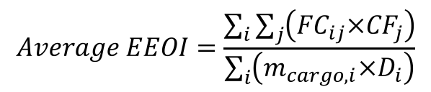
Calculation Process
Physics models
  Bottom-up approach
  Operational experience
  Model tests and sea trials data
Includes Secondary effects
  engine, propeller, etc.
  combinations - e.g. 2% + 2% ≠ 4%
Comparison with 2010 ships
  based on Third GHG Study 2014
EEOI used to measure transport efficiency
$$Average EEOI=\frac{\sum_{i}{\sum_{j}{\left({FC}_{ij}×{CF}_{j}\right)}}}{\sum_{i}{\left(m_{cargo, i}×D_{i}\right)}}$$
Notes:
This is requite a crude summary but there is a more detailed explanation in paper.
Baseline includes
a 9% fouling and degradation factor
bulbous bows and a standard autopilot
exhaust gas boiler/economizer

Slide 7
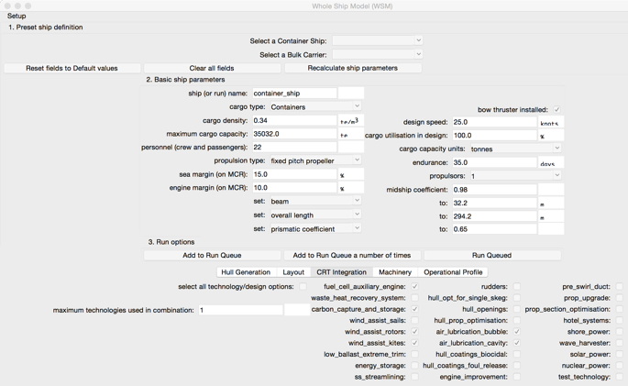
Calculation process
Whole Ship Model:
  complex sub-models
  design process and an operational performance evaluation process
Whole Ship Model (WSM)
Operation
Costs
Ship Design
Efficiency Measures
Weather
Performance Evaluation
Notes:
Whole Ship Model (WSM) is holistic and extensible, ship performance can be assessed with a range of technologies over a range of ship types, design specifications and operational conditions.

Slide 8
Calculation process
EEOI and design speed
2010 ship specifications used for a:
14.8 knot MR Tanker with a 11.7 knot EEOI speed
25.1 knot 5000 TEU ship 16.3 knot EEOI speed
15.3 knot Panamax Bulk 11.9 knot EEOI speed
From the Third GHG Study
(MEPC 67/Inf. 3, 2014)

Slide 9
Calculation process
EEOI and design speed
2010 data
[MEPC 67/INF.3]
[MEPC 68/INF.24]
Whole Ship Model
Efficiency method selection
ship design and performance evaluation
Survey on the use of efficiency methods
2015 survey
[MEPC 69/INF.8]
feedback from shipping organizations

Slide 10
Energy efficiency methods being used in 2015 [MEPC 69/INF.8]
Large survey of ship owners and operators on energy efficiency measures, Rehmatulla and Calleya (2016)
Survey confirmed some preconceptions
  Widespread use of bulbous bows, pre/post-swirl devices, engine modifications and waste heat recovery
  Generally, adoption is small

Slide 11
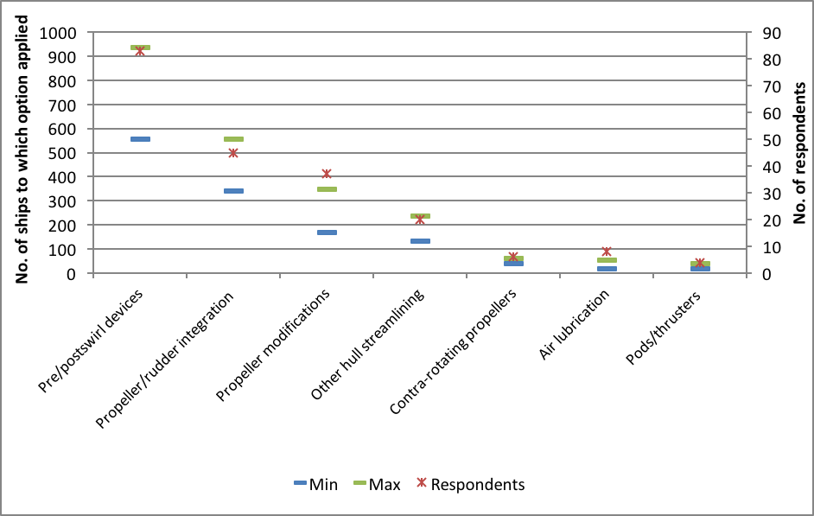
Energy efficiency methods being used in 2015 [MEPC 69/INF.8]
Implementation of Hydrodynamic Measures in 2015, Rehmatulla and Calleya (2016).

Slide 12
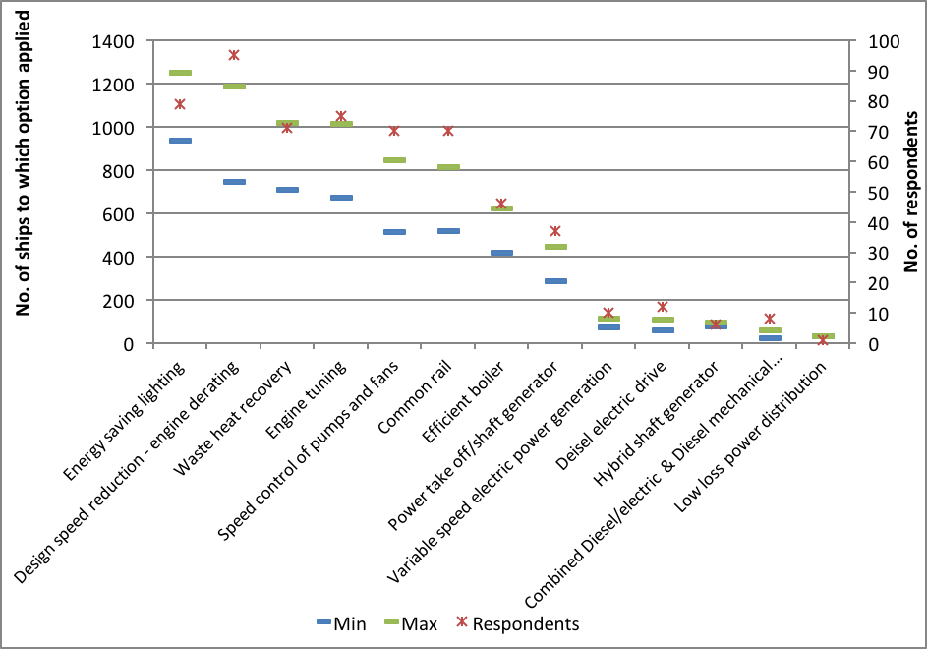
Energy efficiency methods being used in 2015 [MEPC 69/INF.8]
Implementation of Design Measures in 2015, Rehmatulla and Calleya (2016).

Slide 13
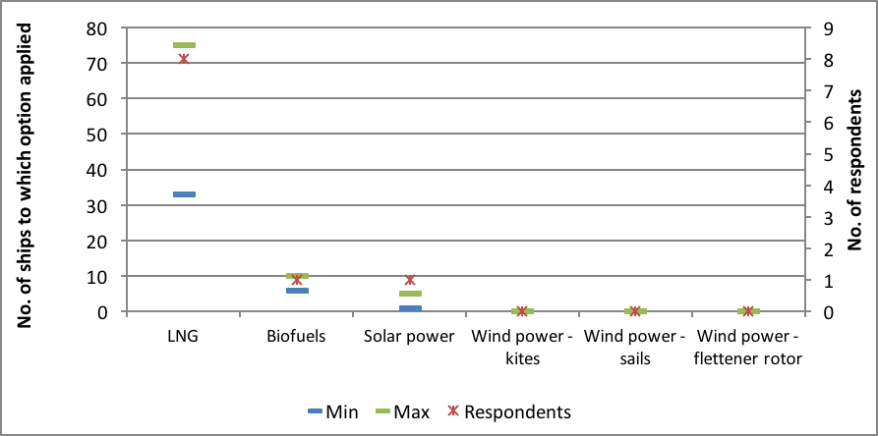
Energy efficiency methods being used in 2015 [MEPC 69/INF.8]
Implementation of Alternative Energy Sources in 2015, Rehmatulla and Calleya (2016).

Slide 14
Technology Efficiency Method combinations
Current technologies combination | Future technologies combination
Rudder Bulb | Contra rotating propeller
End-plated Propeller
Engine Derating | Engine Derating
Speed control of pumps and fans | Speed control of pumps and fans
Energy saving lighting | Energy saving lighting
WHR Steam | WHR Steam
 | WHR Organic Rankine Cycle (ORC)
 | WHR series turbocompounding
 | High cost hull coating
 | Air lubrication
 | Stern flap or block coefficient reduction (depending on the ship type)
 | Maximum Flettner Rotors (not containers)
Technologies that are not widely used
Notes:
Many of the possible future technologies that were examined are available on the market at the moment, all measures are technically feasible.
“Future” compared to “current” technologies:
Examined more unconventional methods for recovering waste heat
A more expensive hull coating was used
A contra-rotating propeller was used replacing the end-plated propeller and rudder bulb
Air Lubrication and Flettner Rotors were included

Slide 15
Efficiency methods for a MR Tanker with a 14.8 knot design speed
 | Operating Speed (knots) | Baseline | Rudder bulb | Vane wheel | Contra rotating propeller (CRP) | End plated propeller | Air lubrication (AL) | Min. Flettner rotor | Max. Flettner rotor (FR)
MR Tanker – hydrodynamic and renewable | 4.4 | 80.2% | 80.0% | 79.9% | 80.9% | 80.0% | 86.2% | 71.3% | 73.0%
 | 5.9 | 72.0% | 71.7% | 71.4% | 72.8% | 71.7% | 75.9% | 55.5% | 57.0%
 | 8.8 | 77.6% | 77.1% | 76.6% | 77.6% | 77.1% | 78.6% | 56.5% | 49.1%
 | 9.6 | 82.6% | 82.0% | 81.4% | 81.9% | 82.0% | 83.0% | 60.5% | 52.6%
 | 10.4 | 88.0% | 87.3% | 86.6% | 86.5% | 87.3% | 87.8% | 65.0% | 56.7%
 | 11.1 | 94.2% | 93.4% | 92.6% | 91.7% | 93.4% | 93.6% | 70.4% | 61.8%
 | 11.5 | 98.1% | 97.2% | 96.4% | 95.0% | 97.2% | 97.3% | 73.8% | 65.1%
 | 11.7 | 100.0% | 99.1% | 98.2% | 96.6% | 99.1% | 99.1% | 75.5% | 66.7%
 | 11.8 | 101.5% | 100.6% | 99.7% | 97.9% | 100.6% | 100.5% | 76.8% | 68.0%
 | 12.6 | 110.2% | 109.2% | 108.2% | 105.4% | 109.2% | 108.8% | 84.4% | 75.3%
 | 14.1 | 135.7% | 134.3% | 133.0% | 129.0% | 134.3% | 133.5% | 104.7% | 94.7%
 | 14.8 | 157.0% | 155.4% | 153.8% | 152.0% | 155.4% | 154.5% | 119.0% | 108.0%
The table numbers are the same as ISWG-GHG 1/2/10
Table 1: EEOI of hydrodynamic and renewable methods for a MR Tanker (compared to 2010).

Slide 16
Efficiency methods for a MR Tanker with a 14.8 knot design speed
 | Operating Speed (knots) | Baseline | Block coefficient reduction (BR) | Current combination (used in 2015) | Future combination (with CRP, AL, ORC, BR) | Future combination with wind (with CRP, AL, ORC, BC and FR) | Future combination with FR and 25% carbon factor | Future combination with FR and 50% carbon factor | Future combination with FR and 75% carbon factor
MR Tanker – block coefficient reduction and combinations | 4.4 | 80.2% | 79.7% | 79.3% | 85.7% | 70.8% | 53.1% | 35.4% | 17.7%
 | 5.9 | 72.0% | 71.3% | 71.0% | 74.8% | 53.8% | 40.4% | 26.9% | 13.5%
 | 8.8 | 77.6% | 76.1% | 76.3% | 74.8% | 42.7% | 32.0% | 21.4% | 10.7%
 | 9.6 | 82.6% | 80.8% | 81.1% | 77.7% | 45.1% | 33.8% | 22.6% | 11.3%
 | 10.4 | 88.0% | 85.8% | 86.3% | 81.1% | 48.0% | 36.0% | 24.0% | 12.0%
 | 11.1 | 94.2% | 91.5% | 92.4% | 83.5% | 50.1% | 37.6% | 25.0% | 12.5%
 | 11.5 | 98.1% | 95.1% | 96.1% | 83.7% | 50.1% | 37.6% | 25.1% | 12.5%
 | 11.7 | 100.0% | 96.9% | 97.8% | 84.7% | 51.0% | 38.3% | 25.5% | 12.8%
 | 11.8 | 101.5% | 98.2% | 99.2% | 85.5% | 51.8% | 38.8% | 25.9% | 12.9%
 | 12.6 | 110.2% | 106.2% | 103.7% | 90.3% | 55.9% | 42.0% | 28.0% | 14.0%
 | 14.1 | 135.7% | 129.3% | 126.5% | 109.3% | 68.7% | 51.5% | 34.3% | 17.2%
 | 14.8 | 157.0% | 148.3% | 146.1% | 131.4% | 79.5% | 59.7% | 39.8% | 19.9%
The data here is represented as a percentage EEOI:
% reduction = (1-%EEOI)
Table 3: EEOI of block coefficient reduction and combinations of methods for a MR Tanker (compared to 2010).

Slide 17
Efficiency methods for a MR Tanker with a 14.8 knot design speed
For this particular ship at the EEOI speed:
  A 2.2% reduction in EEOI from combining 6 technologies that are currently in use
  A 15.3% reduction in EEOI from combining 11 possible future technologies
  …this is potentially 49% if Flettner rotors are included
  An additional 3.1% reduction in EEOI was found from operational methods
The potential reduction in EEOI varies depending on the particular ship

Slide 18
Comparison with existing studies
MEPC 69/Inf.11 by SSPA, contains experiences with ships fitted with efficiency methods.
MEPC 63/Inf.2 and MEPC 69/Inf.18 have similar emission reductions to those calculated here
The Second IMO GHG Study identified reduction potentials of 25-75% on 2007 ship parameters
All studies consider speed as an efficiency method

Slide 19
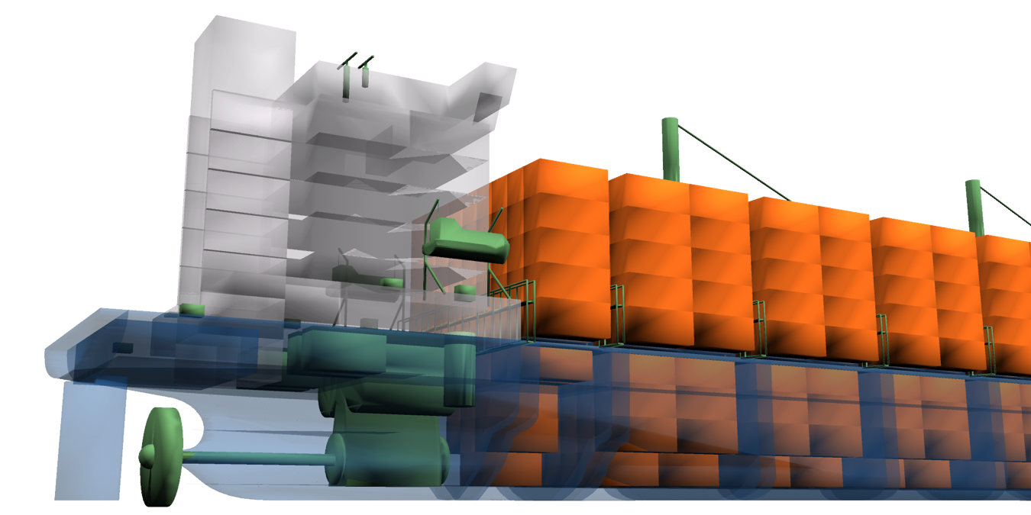
Designing ships to particular speeds and conditions
Ships in 2010 were designed for a higher design speed, but operated at lower speeds
As ships operate away from their design point the efficiency of components of the ship and efficiency methods can decrease
Notes:
For example, a conventional waste heat recovery plant is only effective close to the it’s design point
Also as ship speed changes the relationship between the main and auxiliary engine fuel consumption changes

Slide 20
Conclusions
Further operating speed reductions do not necessarily result in EEOI reductions as the ship’s equipment away from design point
Assuming that the same operational EEOI speed is maintained
  2.2% to 4.7% reductions from technologies in use in 2015
  7.5% to 19.4% reductions are possible from efficiency methods
  53.8% to 90.5% reductions are possible from wind and fuels
Much higher EEOI reductions require the use of wind energy and/or fuels with a lower carbon factor
Notes:
Consistent with other studies
lower carbon factor - electrification, bioenergy or synthetic fuels

Slide 21
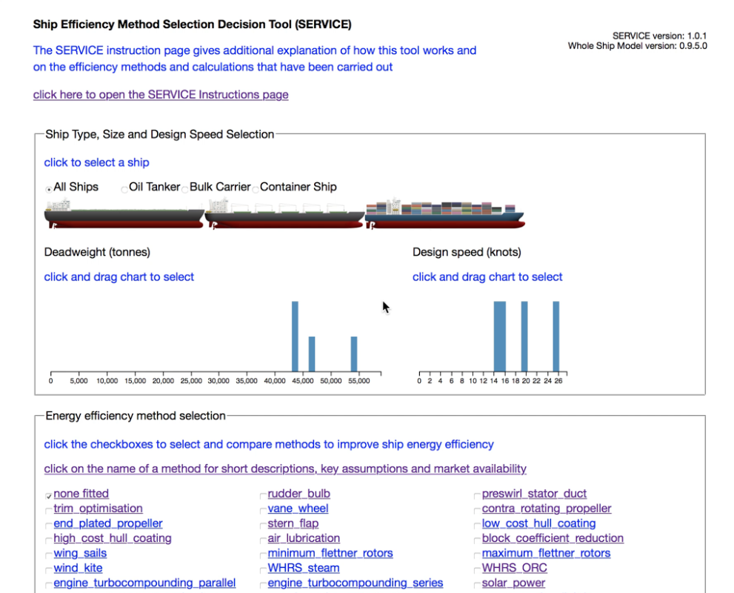
efficientshipdesign.com
Efficiency method decision tool with IMO paper data is at:
www.efficientshipdesign.com
This includes a cost and profit calculator for a range of efficiency methods and operating speeds
click on each efficiency method for an explanation
Efficiency method decision tool was funded by a UCL Impact Acceleration Award and was developed with the Sustainable Shipping Initiative.

Slide 22

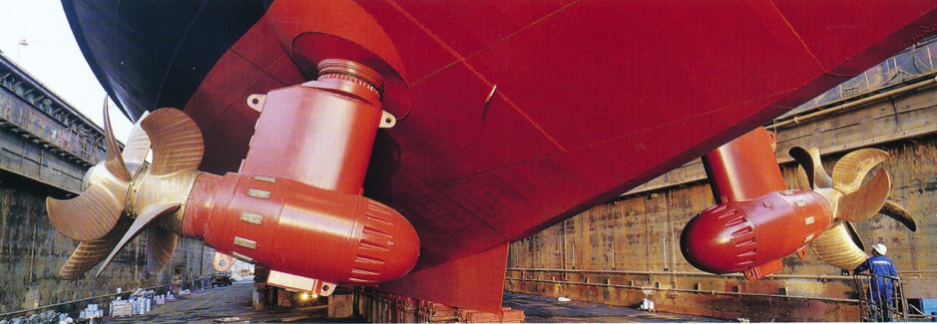
Efficiency method decision tool with IMO paper data is at:
www.efficientshipdesign.com
some work was carried out by U-MAS
http://www.u-mas.co.uk
(download presentation:
www.efficientshipdesign.com/imopresentation.pptx)
Image from Hans Otto Kristensen, CONTAZ units, Contra Rotating Propellers
santiago.fuente.11@ucl.ac.uk
Pease e-mail for sources/data/references

